Slide 1

Blue Man Group
Andrew Plummer and Lorenzo Macaluso
November 14, 2012

Slide 2
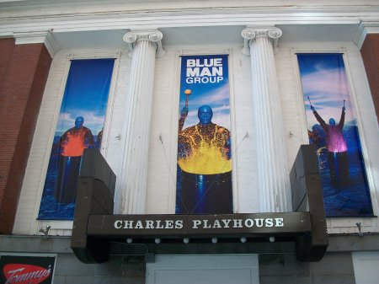
Charles Playhouse, Boston
Notes:
Give introductions, talk about the show and the theatre for anyone who is not familiar

Slide 3

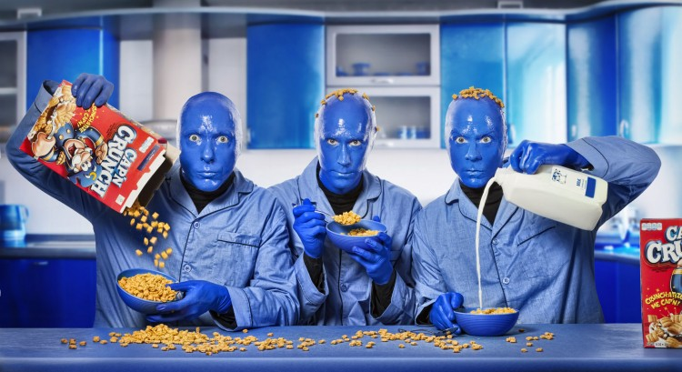
Evaluating the Existing
Recycling Program and Need

Slide 4
Process Evaluation
Hauler Service Analysis
Cost Analysis
Notes:
Introductions, talk about the

Slide 5
Implementation

Slide 6
Changes to the existing program
Single Stream Recycling
Food Waste Diversion
Employee Training and Commitment
Proper Signage
Proper Signage
Notes:
Introductions, talk about the

Slide 7
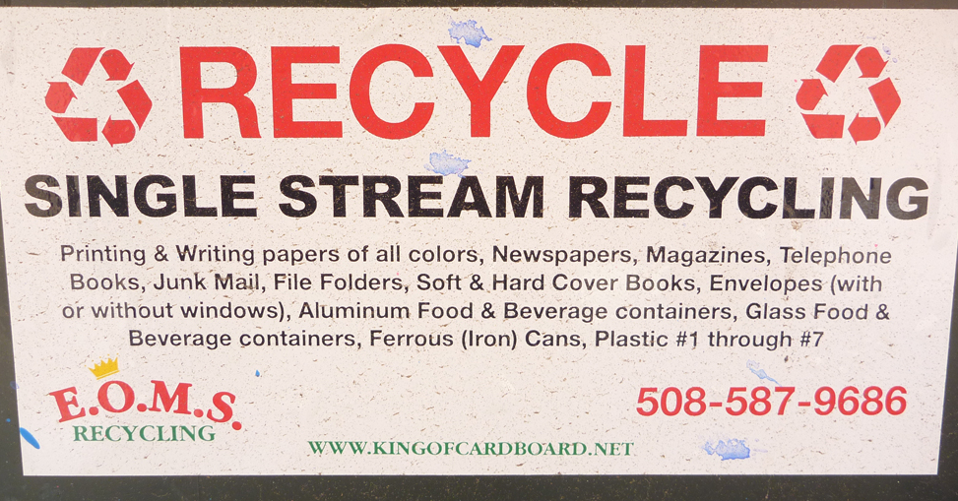
Single Stream Recycling

Slide 8
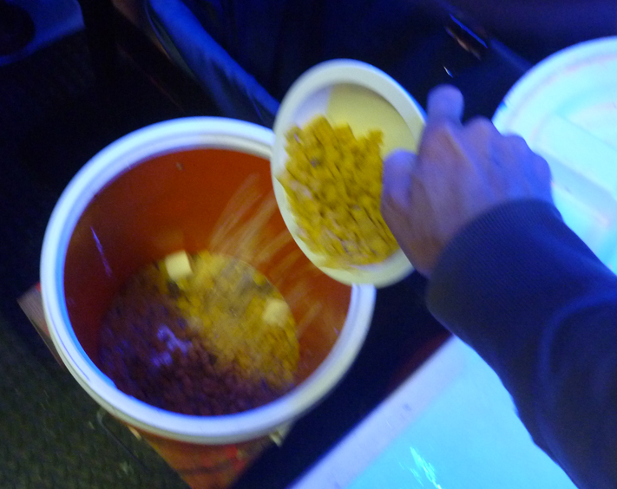
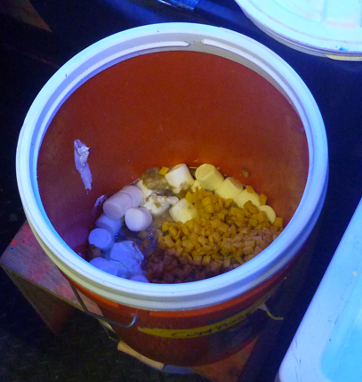
Food Waste Diversion

Slide 9
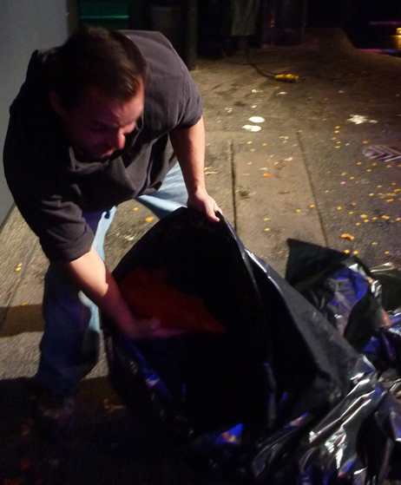
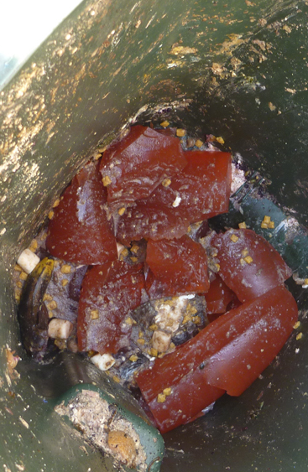
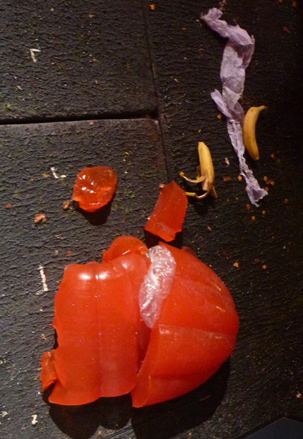
Employee Training and Commitment

Slide 10
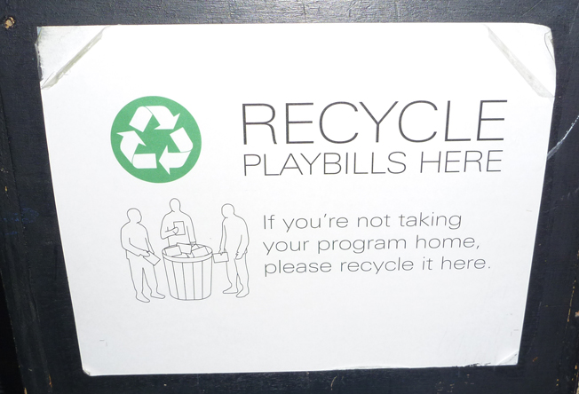
Proper Signage

Slide 11
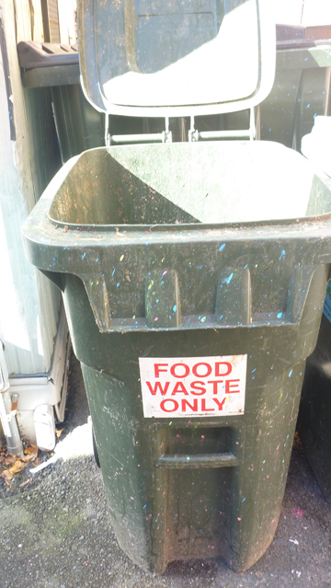
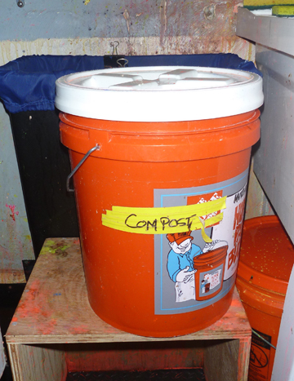

Slide 13
Evaluation

Slide 14
Diverting over 42 tons of recyclables and food waste annually.
70% savings on disposal costs.
Equivalent energy savings to power 15 homes a year!

